Slide 1

EXPLORA PROCESS
The Process Intelligence Platform
JULY 4th - 5th 2019
www.integris.it

Slide 2
OUR MISSION
Make your decisions simpler providing disruptive Data Analytics, Cognitive and Predictive Solutions, that allow you to explore "complex constellations of data" for getting more out of data and gain competitive advantage.
This is our mission.

Slide 3







INTEGRIS CORE BUSINESS OFFERING
(Big) Data Analytics
Descriptive / Predictive Analyitics
Customer Behavior Analysis
Cross Selling / Upselling Analysis
Outlier Detection
Predictive Maintenance
Customer Experience Management
Process Intelligence / Mining
IoT Analytics
Cognitive Computing
Sentiment Analysis
Brand Reputation Analysis
Information Extraction
Semantic / Intelligent Search
Media Monitoring
Competitive Analysis
Documental Classification (semantic / automatic)
BOT / Service Automation
Conversational AI / Digital Assistant
ICT Services
IT Solutions
(Design and Implementation)
System Integration
IT / Applications Modernization
Support / Maint. Services
Microsoft, Hitachi, Pentaho, IBM, Tibco, Oracle, Splunk

Slide 4
EXPLORA PROCESS: THE PROCESS INTELLIGENCE PLATFORM
Explora Process is a BIG DATA Process Mining solution that can analyze any business process, representing exactly how it is performed.
Applying specialized data mining algorithms to event log data, Explora Process allows to identify in a quick and convenient way, trends, patterns, weaknesses, bottlenecks or inefficiencies of a process in its real execution, identifying any deviations from the defined reference process.
Explora Process is a powerful decision support tool that can help increase efficiency and optimize time and costs of execution of its business, providing accurate information about real process running performance and a predictive view of process working way.
UNDERSTANDING PROCESSES
TO BETTER PERFORM

Slide 5
EXPLORA PROCESS
SUPPORTING YOUR INNOVATION NEEDS
The speed and agility of managing change and drive digital transformation are today fundamental success keys for companies, of any size and in any market. And processes are important constituents in the operationalization of whatever digital business initiative.
Explora Process allows you to deeply understand real execution of your processes, supporting you to decide more quickly the change to be applied to speed up or improve processes, to achieve best business performance and resources usage optimization.
Best understanding and graphical visualization of your way of running business, allows to best and more effective approach to:
change, update, adapt, evaluate processes
Rethink a process
Improve, optimize processes
BEING MORE
AND MORE AGILE

Slide 6

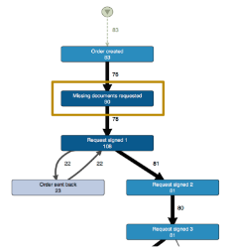
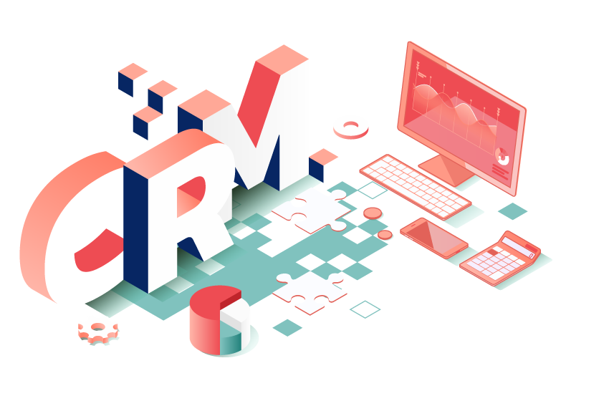
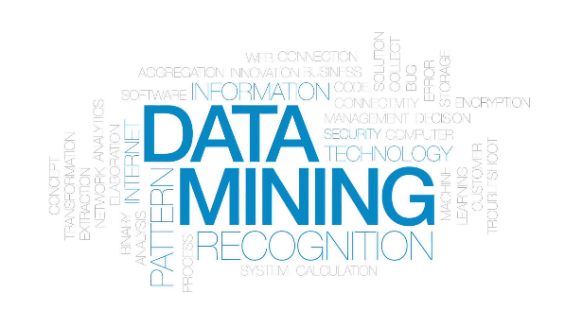

MAIN REFERENCE PROCESSES AND INTERESTED BUSINESS ROLES
FOR ANY PROCESS, IN ANY MARKET SECTOR
Explora Process allows to analyze any type of processes, regardless of the market sector, through the analysis of “digital traces” of each process.
Order To Cash, Procure To Pay, Accounts Payable, Accounts Receivable, Credit Risk Management , Accounting, Customer Care / SLA, Service Activation , Logistic / Delivery
DATA COLLECTION
DATA ANALYSIS
EXPLORA PROCESS
DASHBOARD
Databases and applications
(ERP, SAP, DYNAMICS, CRM)
Analysis of activities based on logs
Loading of data on Explora Process
Processes, variants, cases analysis

Slide 7



EXPLORA PROCESS: THE PROCESS INTELLIGENCE PLATFORM
DISCOVER
Automatically discover the processes, as they really performed by your company, and without prior knowledge of the process itself.
Transform data from logs and from “digital traces“, to visualize the process performed through simple and intuitive graphical representations, showing all the variants of current running processes.
Regardless of the typology and complexity of the analyzed process.
UNDERSTAND VERY EASILY THE WAY YOUR COMPANY RUNS BUSINESS TO CARRY OUT PRODUCTS OR SERVICES
CHECK
Check if your performed processes are compliant with reference process model.
Detect process variants, supporting gap-analysis or outlier detection.
Support conformance checking in your audit and SLA measurement activity.
Support identification of the actions needed to guarantee Process Compliance.
PROVIDE PROCESS COMPLIANCE CONFORMANCE CHECKING TO BETTER PERFORM ACCORDING TO STANDARDS
IMPROVE & PREDICT
Identify good practices in your process management, and discover direct connections between inefficiencies root causes and solutions, thanks to advanced insights.
Use Artificial Intelligence to predict how your process will perform (time and costs).
Calculate, for the analyzed time intervals, the costs of activities, cases and resources involved in the process.
PROVIDE KNOWLEDGE TO MANAGE CONTINUOUS IMPROVEMENT AND BEING MORE AND MORE AGILE

Slide 8
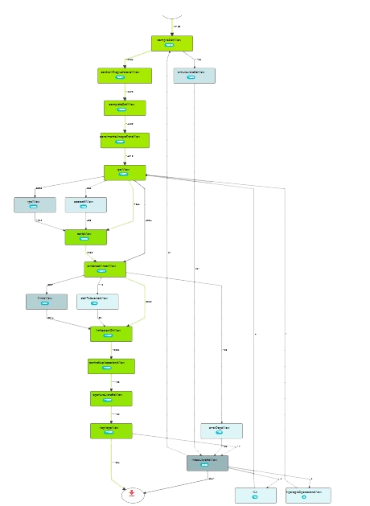
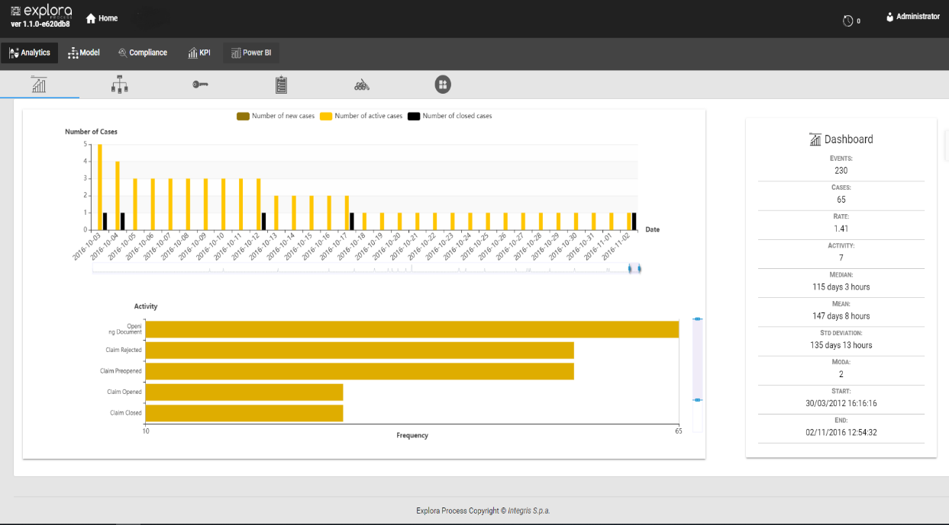
EXPLORA PROCESS: OPTIMIZE OPERATIONS TO DRIVE ACROSS YOUR BUSINESS
KNOW MORE FROM YOUR DATA
TO ACHIEVE OPERATIONAL EXCELLENCE.
IMPROVE YOUR PROCESSES SAVING MONEY
EXPLORA PROCESS IS A POWERFULL SOLUTION TO:
Support and accelerate Digital Transformation roadmap
Optimize processes to achieve operational excellence
Identify good practices in you running business
Guarantee Process Conformance Checking
Support decisions with advanced insights, to be more and more agile

