Slide 1


Slide 2


> INTRO

Slide 3

> INTRO
> PROBLEM STATEMENT

Slide 4
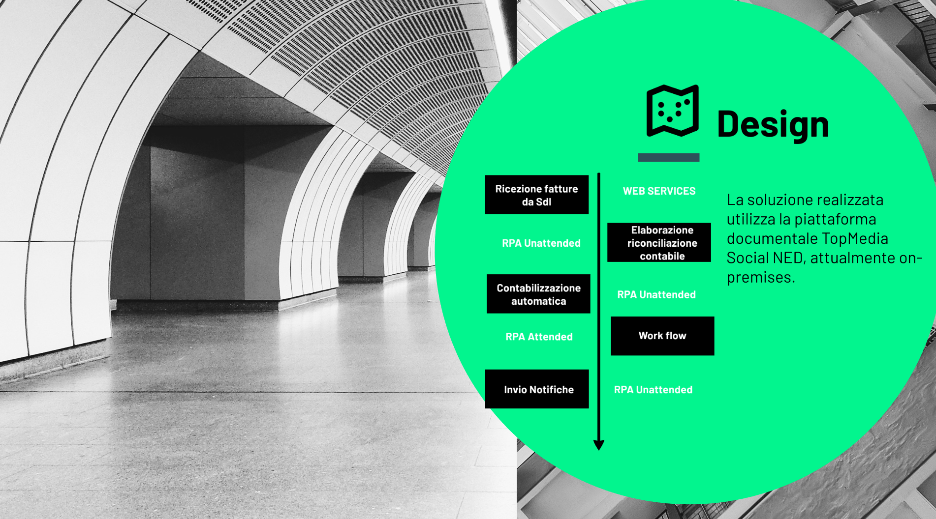
> DESIGN

Slide 5
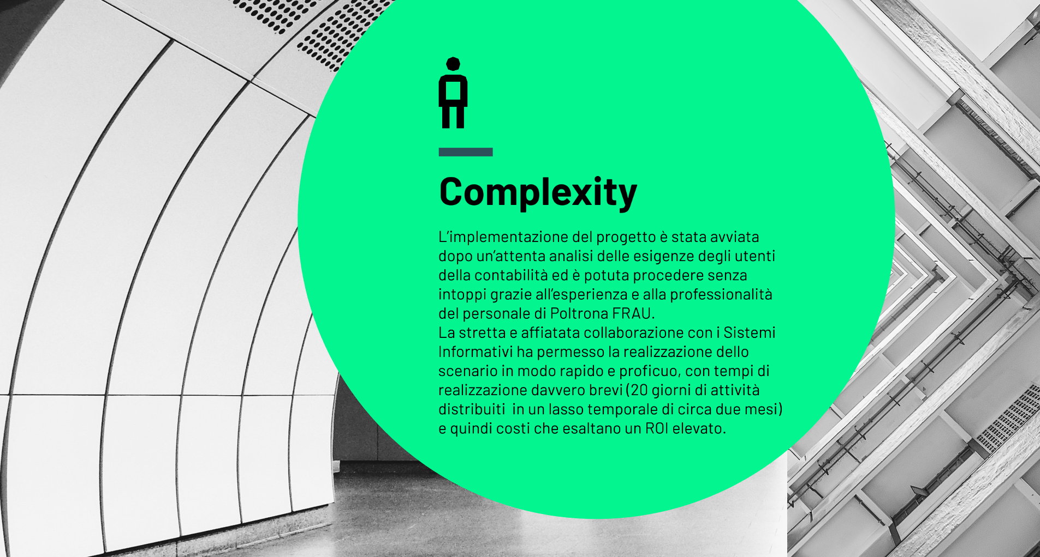
> COMPLEXITY

Slide 6

> GOALS

Slide 7

> INNOVATION

