Slide 1
WINDTRE Protects its Growing Business with Qualys
Guido Galli de Paratesi
26th January 2021

Slide 2
WINDTRE Cyber Security Pillars
Cyber
Intelligence
Vulnerability
Management
Security Incident Management

Slide 3

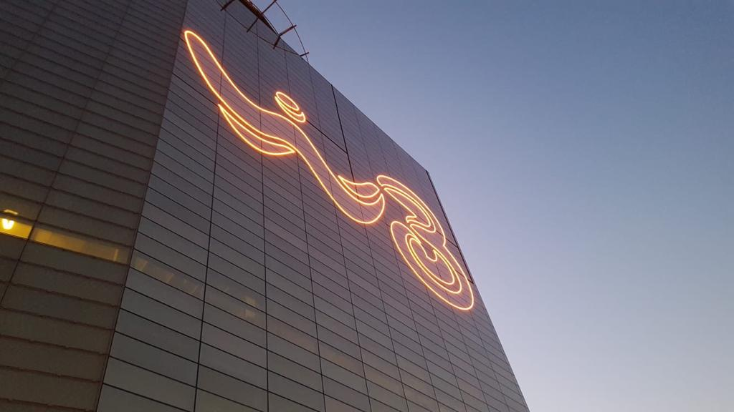
WINDTRE was born from the merger of Wind Telecomunicazioni S.p.A. and H3G S.p.A.
WINDTRE is the number one mobile operator in Italy and among the main alternative carriers in the fixed-line market
The company offers a comprehensive range of products, including mobile, fixed-line and internet services for consumers and businesses

Slide 4



The Challenge
Ensure information security supporting the grow of the business
NEW VULNERABILITY MANAGEMENT APPROACH
AND SOLUTION
Manage different manual processes and systems upon a doubled server estate

Slide 5
Solution Selection
System Requirements
Operational Objectives
Easy and fast deployment
Support of different endpoint technologies
Support of EOL OS
Low operational costs
Native interoperability towards the main SECOPS platforms
Powerful reporting functionalities
Low impact on the target systems operations
Increase the frequency of vulnerability detection
Detect the vulnerability status regardless the location of the endpoint
Continuous monitor the perimeter of IPs exposed to public
Organize the results of the VAs in a single, centric asset environment, easily searchable

Slide 6

Solution Implemented ( 1st STEP)
Qualys Agents
Internal Scanners
External Scanners
Cloud Platform
Qualys Gateway Services

Slide 7
Qualys Solution Implementation / Results
Qualys Agents
QGS
Internal & External Scanners
Employees PCs
WINDTRE shop PCs
Windows and Unix Servers
Reachability from protected network segments
Support for TLS 1.0
Future support for patching activities
Internal Scanners to support VA on network elements (e.g. firewall, switches) or database instances
External scanners to support VA on external perimeter
Collection every 4 hours of the vulnerability status of WINDTRE PCs and servers (also outside the company)
No impact on PC and server performances
Very low usage of resources
High level of reliability
Weekly Vulnerability Assessment of WINDTRE public perimeter (*) considering thousands of ports across hundreds of thousands IPs.
(*) Does not include WINDTRE Customers address plan

Slide 8
Solution Implemented ( 2nd STEP)
Qualys Agents
Internal Scanners
External Scanners
Cloud Repository
Qualys Gateway Services
Qualys APIs
IOC

Slide 9
Qualys Solution Implementation / Results (2nd Step)
Qualys APIs
IOC(*)
Integration with other SECOPS applications by APIs
Using the Cloud Agent already deployed and upgraded
Integration with WINDTRE Data Lake, SIEM (Splunk) and security automation solutions (Service Now SECOPS)
Additional detection to the one supplied by the standard antivirus feeding the incident response processes
COVID-19
(*) EDR

Slide 10
Next Steps
Qualys Gateway Services
Qualys APIs
IOC
….
Policy Compliance (PC)
Web Applications Scanning (WAS)
Continuous Monitoring (CM)

Slide 11
Conclusions
Qualys implementation turned out to be simple and fast to implement.
The long POC approach allowed to identify progressively for each Qualys feature the best implementation and to have ready solutions facing new security issues.
Thanks to its stability, non-invasiveness and ease of integration with third party applications the solution has permitted to limit the project implementation costs.
The new Vulnerability Assessemnt approach based on Qualys Agents and Qualys Cloud Platform has enabled the capability to detect continuously the status of WINDTRE assets independently to their location, and without impact the WINDTRE production processes.
Thanks to Qualys solutions, WINDTRE has a single, trusted view to keep all its assets safe and its sensitive data protected at all times.

