Slide 1

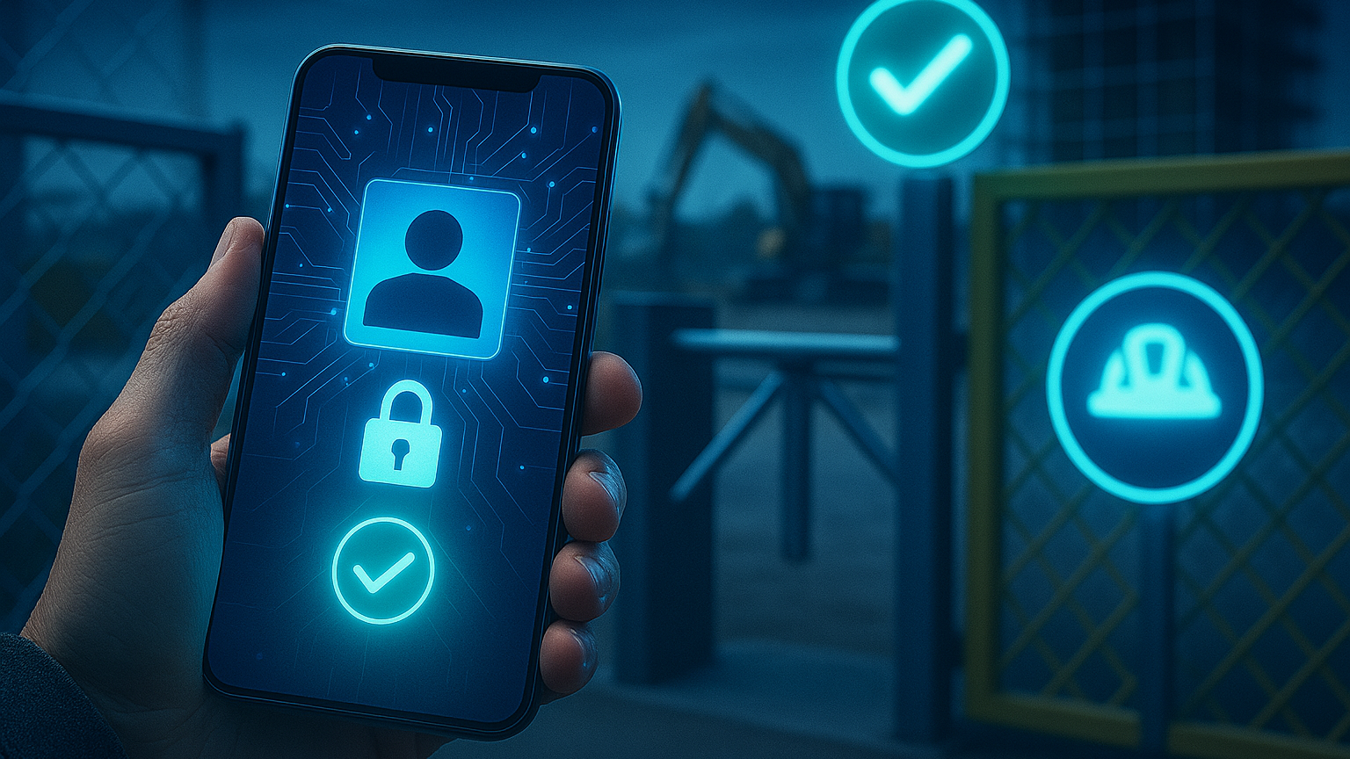

Employee Wallet – Digital360 Contest
IT

Slide 2
Overview

Slide 3

It enables the management and storage of identity documents and other identity-related information. Our state-of-the-art solution is aligned with European Commission standards, in particular OpenID4VC and VP under the Architecture Reference Framework (ARF).
The Infocert Wallet is an ecosystem of verifiable credentials and a digital wallet that manages and enables the secure sharing of information and identity attributes of a natural or legal person, where the user himself is the owner of the information.
We are actively modelling two of the Large Scale Pilots, influencing the future of eIDAS 2.0 for the European Digital Identity Wallet.
The wallet effectively addresses the use cases defined by the eIDAS 2.0 regulation, enabling a wide range of applications in both physical and digital environments.
InfoCert Wallet allows users to independently choose which information to share and which credentials to add or remove.
Tinexta InfoCert is the Trust Governance Authority of the InfoCert Wallet ecosystem.

Slide 4

The Digital Wallet and European Regulations
The Digital Wallet is based on the technological principles of the EUDIW (European Digital Identity Wallet) but can already be used to enable digital processes.
Electronic signature/seal: e.g., sign a contract to open a bank account; authorize a payment.
Filing and presentation of certificates of attributes: e.g. presenting a driving license to rent a car.
Identification/authentication shares the identity data needed to access both public and private services.

Slide 5
InfoCert Wallet Capabilities and Convergences with EUDIW

Slide 6













Towards the Future of Digital Identity​​
50M
funding
LARGE SCALE PILOTS
Influence the Toolbox evolution
Test the Prototype
27M
funding
WALLET PROTOTYPE
Implement the Toolbox
Influence the Toolbox evolution
Delivered to LSPs
TOOLBOX (ARF)
Specifications for LSPs
Influenced by Prototype and LSPs
APTITUDE

Slide 7




InfoCert Wallet Framework
Enrollment
Credential Management
AUTHENTICATION
WALLET
This process includes:
- Credential creation and activation
- Credential storage
- Credential suspension, revocation
This process includes:
- Strong Authentication
- Record-keeping
This process includes:
- Identity Proofing
- Identity information verification
Api +
WIDGETS
SCHEMAS
& TRUST
IDENTITY
ISSUER VC
VERIFIER VC
PKI
CERTIFICATE
SIGNATURE

Slide 8


InfoCert Wallet Capabilities
Credentials
Management
Proof
Authentication
Signature
Notifications
It is possible to be identified smoothly and securely by enabling selective information sharing through the Zero Knowledge Proof approach.
Thanks to OpenID Connect technology, you have one universal access for everything, web and mobile, without the need for username and password.
Real-time messages in the owner's wallet via a secure channel.
Possibility of signing contracts and documents with qualified electronic signatures via the wallet.
Real-time messages in the owner's wallet via a secure channel.
Management of verified credentials towards any entity, such as Financial Institutions, Public Administration, Private Companies.
Easy management of certified credentials
Secure and reliable online identification
Encrypted Instant
Messaging
OpenID Connect
eSignature

Slide 9
Success Case – Employee Wallet for critical sites

Slide 10
SCENARIO
Access control on construction sites or critical site management: a critical priority to prevent legal, operational and safety risks
In the construction & maintenance sector, companies manage temporary and mobile worksites, characterized by:
The presence of external personnel (e.g. subcontractors, technicians, inspectors)
Access to sensitive or hazardous areas
Stringent obligations related to worker safety and data protection
Untracked or unauthorized access exposes the company to serious risks:
Workplace accidents with potential legal and reputational consequences
Penalties due to non-compliance with regulatory requirements
Inability to identify responsible individuals during audits or inspections
Case Example – Large Infrastructure Operator In Italy - Critical need to ensure every worker is properly identified, authorized, and trained before accessing the worksite. Main operational challenges include:
Distributed and fragmented control across multiple active sites
Unauthorized access → risk of legal or financial liability
Complexity in managing and verifying access credentials

Slide 11










SOLUTION
1
InfoCert Wallet is a digital wallet compliant with eIDAS 2.0 and part of the European EUDI Wallet initiative.
It enables workers and operators to securely store and present credentials:
Digital identity, training certificates, and qualifications (e.g., safety courses, licenses)
Qualified attributes (e.g., clearance for working at heights)
Usage flow on construction sites:
The worker completes onboarding via a remote or on-site KYC process and receives digital credentials (personal data, role, training).
At the construction site entrance, the Wallet is presented: access is granted only if all requirements are met.
The solution can be easily integrated with existing access control systems.
IDENTITY VERIFICATION
CREDENTIAL
ISSUING
CREDENTIAL
VERIFICATION
SITE ACCESS VERIFIED

Slide 12

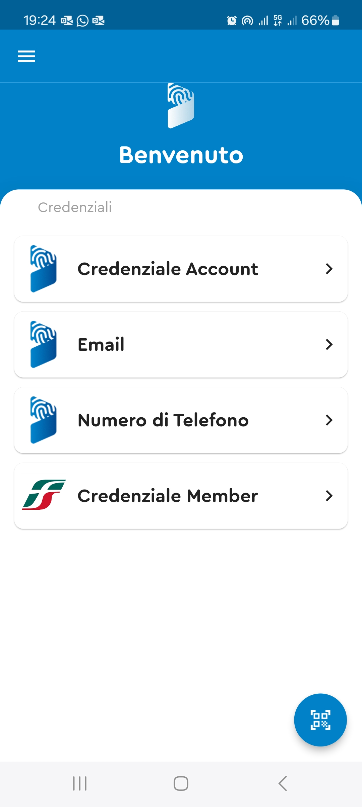
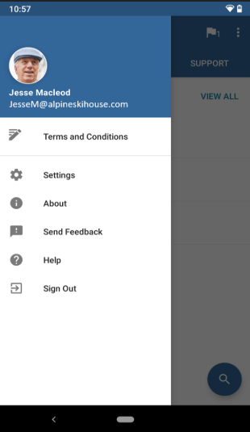





SOLUTION
2
COMPANY
IDENTIFIED WORKER
WORKER
CLIENT
APPLICATION
END USER
JOURNEY
Certified identification of end users
Presentation of Verifiable Credentials: «Membership»
IC WALLET
INTEGRATION
SDK
API REST
OpenID Connect
Customer application becomes identification intermediary for the end user.
Allows the Customer Application to act as a verifiable credential manager.

Slide 13
Thank you

